Slide 1
Lecture 11
Unsupervised Learning

Slide 2
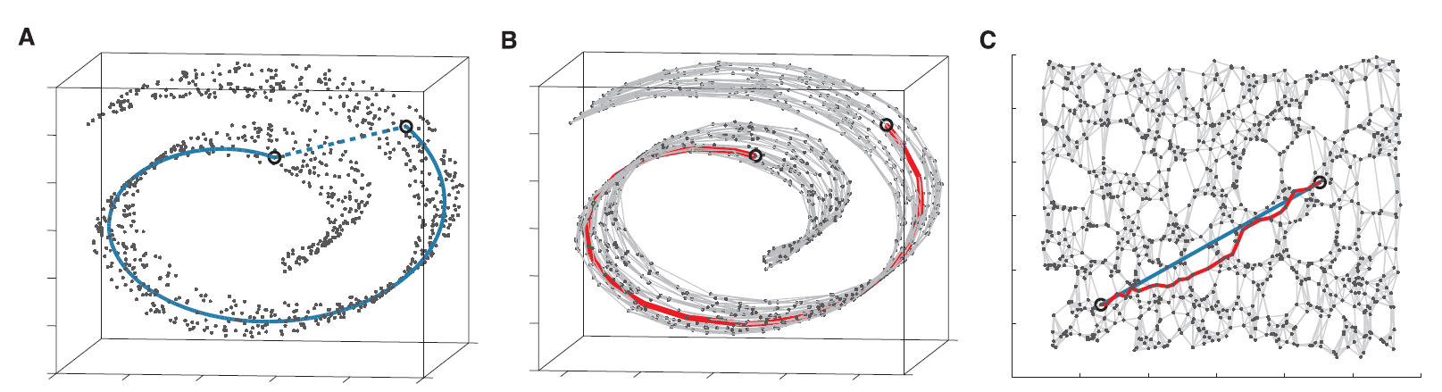
Unsupervised Learning
Unlike the supervised case, there is no “desired response” for any stimulus.
Instead, the system tries to infer some characteristic structural aspect of the data, e.g. clustering or lower-dimensional representation.
An Important Observation:
Unsupervised learning is mainly useful when the data/stimulus has redundancy, i.e., the actual information it carries is less than the “representational volume” of the signal.
Example: ISOMAP
2-dimensional data
embedded in
3-dimensional space.
Tenenbaum, J.B., de Silva, V. and Langford, J.C. (2000) A global geometric framework for nonlinear
dimensionality reduction, Science 290: 2319-2323.

Slide 3
What Unsupervised Learning Can Do
Similarity Detection: Deciding whether the current stimulus is similar to something
seen (and learned) before? And how similar?
Associative Memory: Recalling classes or objects based on similarity.
Clustering: Grouping data into clusters based on feature similarity.
Prototyping: Extracting prototypical representations of classes obtained by clustering.
Principal Component Extraction: Extracting the principal components of a dataset.
Dimensionality Reduction: Mapping high-dimensional data to fewer dimensions.
Recoding: Generating more concise representations of complex data.
Feature Mapping: Creating a topographic map of the input based on feature similarity.
We will focus mainly on clustering and feature mapping.

Slide 4
Clustering: Essential Elements
Feature space: The space in which the data lives
Similarity measure: A function which quantifies the similarity between two data points.
e.g.
where is the Euclidean norm.
measures the cosine of the angle between x¹ and x²
and if x¹ and x² are collinear, 0 if orthogonal.
Direction cosine
Cosine similarity
Distance measure: A norm measuring the distance between data points,
e.g. Euclidean norm.
Cluster center: An archetypal “center” or “mean” vector in feature space typifying
a given cluster (sometimes called a centroid, but that is less general)

Slide 5
K-Means Clustering
and a pre-specified set of clusters = C^{k} k = 1,2, …, K
1. Choose K points from and make each one a cluster center α ^{r} , r = 1, . . . , K
2. For all remaining points in , assign each one to the cluster with whose center it has
the greatest similarity (or minimum distance)
3. Compute the centroid of each cluster and make each centroid the center for its cluster
4. Reassign all points with respect to new cluster centers
5. If no reassignments occur, stop. else repeat from step 3

Slide 6
K-Means Clustering Critique
+ Easy to implement
+ Often works well.
Must know K a priori
(often impractical, since finding K is usually the key problem)
- Gets stuck in sub optimal configuration
One alternative
Self-Organized Feature Maps.

Slide 7
Assessing Cluster Quality
The Silhouette Metric
P.J. Rousseeuw (1987). "Silhouettes: a Graphical Aid to the Interpretation and Validation of Cluster Analysis".
Computational and Applied Mathematics. 20: 53-65.
Suppose a clustering C = {C₁ , … C_{m}} has been done with point x^{q} → cluster C_{k}
We calculate a silhouette value for x^{q} as:
where a (x^{q}) ≡ mean distance of x^{q} from all other points in C_{k}
b (x^{q}) ≡ mean minimum distance of x^{q} from all clusters other than C_{k}
where a score near 1 implies that
Silhouette score of the clustering:
N is the number of points
K can be chosen to maximize the silhouette score.

Slide 8
Competitive Learning Networks
We have a 1-layer network of linear units, and inputs x_{j}
θ_{i} = angle(w_{i} , x)
The weight vectors are all normalized, i.e.
If inputs are also all normalized, s_{i} = cosine similarity between w_{i} and x

Slide 9
Network Operation
1. Apply input vector x
cosine similarity
2. Determine
3. Determine the winner i* , the unit with the largest s_{i}
Winner take all (WTA)
5. Update weights
(Note that only the winners weights get updated by this rule)

Slide 10
What does this algorithm do?
WTA → find the neuron whose weight vector is most “similar to”
the input vector. i.e.
This learning rule works best if the x vectors are also normalized. Otherwise, we can use
Renormalize the weight vector of the winner after each step:
Learning Rule → Move the winning neuron’s weight vector “closer to” x.
→ Each neuron’s weight vector converges to the centroid of all input patterns for which it wins = cluster center

Slide 11
To see that the learning moves w_{i} towards x, consider:
=1
≤1
≥ 0

Slide 12
Effect of Learning
Before Learning
After Learning
X
X
X
X
X
X
X
X
X
X
X
X
X
X
X
X
X
X
X
X
X
X
X
X
X
X
X
X
X
X
X
X
X
X
X
X
X
X
X
X
X
X
X
X
X
X
X
X
X
X
X
X
X
X
X
X

Slide 13
Effect of Learning
Before Learning
After Learning
X
X
X
X
X
X
X
X
X
X
X
X
X
X
X
X
X
X
X
X
X
X
X
X
X
X
X
X
X
X
X
X
X
X
X
X
X
X
X
X
X
X
X
X
X
X
X
X
X
X
X
X
X
X
X
X
Dead unit

Slide 14
Non-Radial Clusters
Using to choose the
winner works when the clusters
are “radial”
But what if the clusters are not radial?
X
X
X
X
X
X
X
X
X
X
X
X
X
X
X
X
X
X
X
X
X
X
X
X
X
X
X
X
X
X
X
X
X
X
X
X
X
X
X
X
X
X
X
X
X
X
X
X
X
X
X
X
X
X
X
X
X
X
X
X
X
X
X
X
Use non-normalized weights with

Slide 15
Non-Radial Clusters
Using to choose the
winner works when the clusters
are “radial”
But what if the clusters are not radial?
X
X
X
X
X
X
X
X
X
X
X
X
X
X
X
X
X
X
X
X
X
X
X
X
X
X
X
X
X
X
X
X
X
X
X
X
X
X
X
X
X
X
X
X
X
X
X
X
X
X
X
X
X
X
X
X
X
X
X
X
X
X
X
X
Use non-normalized weights with
Note

Slide 16
In this case, the weight vectors
converge to cluster centers
The algorithm performs a Voronoi
tessellation around the cluster centers
X
X
X
X
X
X
X
X
X
X
X
X
X
X
X
X
X
X
X
X
X
X
X
X
X
X
X
X
X
X
X
X
X
X
X
X
The cluster centers can be regarded as
prototype vectors for each cluster

Slide 17
For normalized x, w_{i,} using to determine the winner is equivalent
to using
In hardware (or even in simulation) WTA can be achieved by lateral inhibition
Whoever reaches firing threshold first, inhibits all others.
Notes:
not sure what symbols to use on drawing.

Slide 18
In fact, competitive learning corresponds exactly to the K-means clustering
method (its on-line variant).
Competitive learning can create dead units: neurons that never win, and therefore never learn.
To prevent these, we can
- Initialize weight vectors using actual input patterns
or
- Use leaky learning, where losing neurons also learn, but at a much lower
rate
→ Their weight vectors drift closer to where the data is.
or
- Use a conscience scheme, where no unit is allowed to win more than a
fraction of the time. (This is hard to stabilize in some cases)

Slide 19
Self-Organized Feature Map

Slide 20
Self-Organized Feature Maps (SOFM)
Kohonen, 1982
Self-organized feature maps use competitive learning in a network whose neurons
are arranged in a metric space, e.g., a 2-dimensional grid.
Neuron Layer
y
x₁
x₂
x_{n}
r_{i} = position of unit i on the grid.
w_{i} = [w_{i1} w_{i2} . . . w_{in} ]^{T}

Slide 21
Learning in the SOFM
Training Algorithm
is a time dependent
neighborhood function
with a peak at i = i*
Given training data points, X ={x^{k}}
1
Present vector
A typical choice is
2
Determine winning unit i*
3
Update all weights by
4
Repeat from
1
where and are fixed parameters.

Slide 22
Effect of Training
The weight vector, w_{i*}, of the winning neuron moves closer to x^{q}
The weight vectors of neurons physically close to i* move towards x^{q} by smaller
amounts that depend monotonically on their distance from i*.
The weight vectors of neurons far from i* do not move much at all.
Over the course of learning, the activity of neurons on the 2-d (or even 1-d)
surface comes to represent the topological/statistical relationships of data in the
input feature space.
→ similar inputs have similar output representations but are
represented by activity on a lower-dim manifold.
This is useful for
- Clustering
- Visualization
- Removal of redundancy (data compression)
- Organization of information onto spatial maps (useful in the brain)
- Inference of structure in the input space.

Slide 23
Two-Phase Learning
Experience has shown that it is often beneficial to divide the learning of SOFM
into two phases with learning rate varied over time by
The Self-Organizing Phase:
This is where the weights go from their initial random organization to one
reflecting the structure of the data:
Start with η_{o} = 0.1, τ_{L} = 1000.
Set the neighborhood function Λ(i, i*, 0) to cover almost the whole network. This
can be done by setting σ₀ ≈ 0.5 r_{max}
Shrink the neighborhood function slowly over 1000 or so iterations. This can be
done by setting τ_{N} = 1000 / lnσ₀ so that σ (1000) = 1
The Convergence Phase:
This refines the learned weights.
Maintain η (t) ≈ 0.01 and Λ(i, i*, t) ≈ 1 (only the nearest neighbors)
Train for about 500 times the number of data points.
From: S. Haykin, Neural Networks: A Comprehensive Foundation, Prentice-Hall, 1999

Slide 24
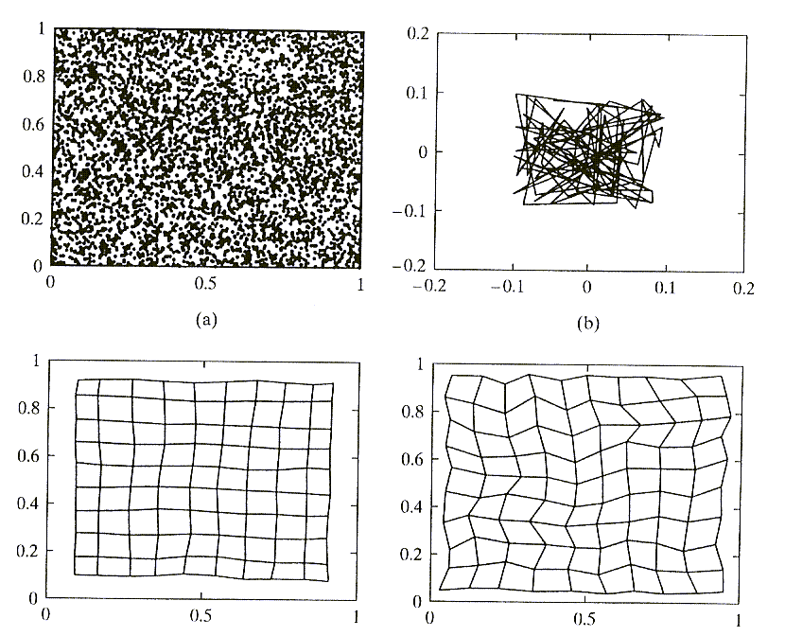
Example 1: Density Mapping
Data → 2-dimensional Neural layer → 2-dimensional
Given set of data points in feature space
(note uniform distribution)
Neighborhood relationships between
initial weight vectors (each is
shown connected to its
4 neighbors)
Neighborhood relationships of weight
vectors after self-organization phase.
Final weight vector neighborhood
relationships after the convergence phase.
The distribution of weight vectors comes to reflect the distribution of data
From: S. Haykin, Neural Networks: A Comprehensive Foundation, Prentice-Hall, 1999

Slide 25
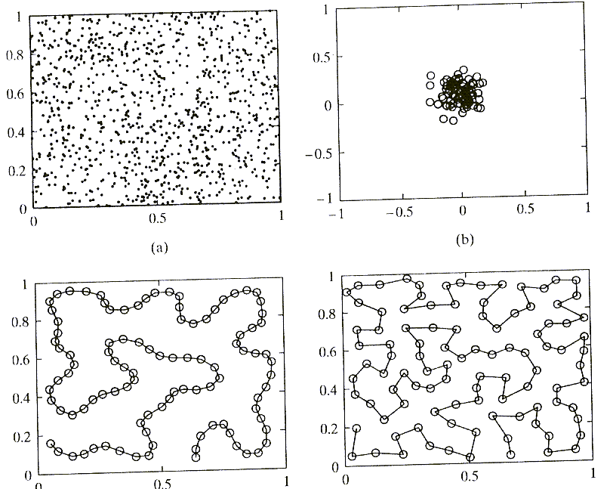
Example 2: Dimensionality Reduction
Data → 2-dimensional
Neural layer → 1-dimensional
Goal: Finding a lower-dimension map of the data that preserves neighborhood
relationships as far as possible.
2-d data
Initial weights
Final weight
vector
distribution
Weights after
learning
Uniform 2-d data is mapped to a space-filling 1-d curve
From: S. Haykin, Neural Networks: A Comprehensive Foundation, Prentice-Hall, 1999

Slide 26
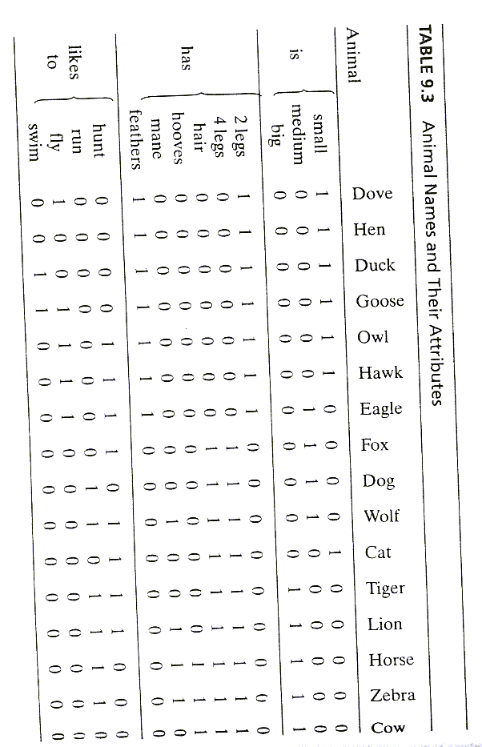
Example 3: Feature Mapping
From: S. Haykin, Neural Networks: A Comprehensive Foundation, Prentice-Hall, 1999
Given: 16 animals with13 attributes
Each animal is represented by:
a 13-bit attribute code
a 1-of-16 symbol code
c = constant
Total representation for animal k

Slide 27
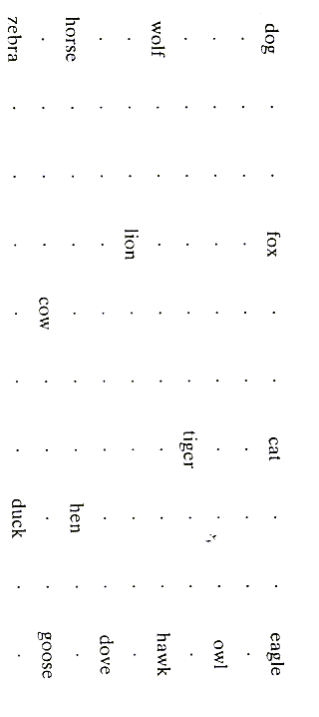
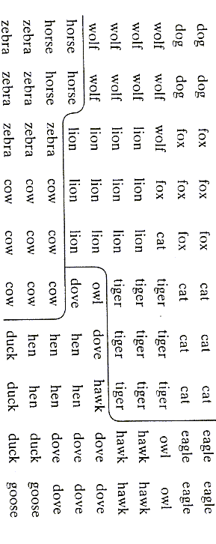
Train on x^{k} for 2000 iterations with a 10 x 10 network
Neurons with maximal response to each animal
where x_{s} is the symbol code for any animal
e.g.
Observations:
Animals are mapped according to their
similarities in attribute space.
Animals of each class are mapped to a
compact cluster of units
Preferred response for each neuron
Note that classes were not given. The system discovered them.

Slide 28
Train on x^{k} for 2000 iterations with a 10 x 10 network
Neurons with maximal response to each animal
where x_{s} is the symbol code for any animal
e.g.
Observations:
Animals are mapped according to their
similarities in attribute space.
Animals of each class are mapped to a
compact cluster of units
Preferred response for each neuron
Note that classes were not given. The system discovered them.

Slide 29
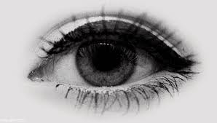
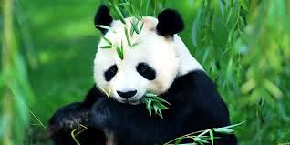

Why is a Feature Map Useful?
Feature maps organize information in ways that are:
Meaningful.
Reflect the structure of information.
Generalize over the information space.
Act as pointers for high-dimensional representational spaces.
Thus, they can be used to improve decision-making, inference and control.
Feature
Map
Speech
Map
Word Map
panda

Slide 30
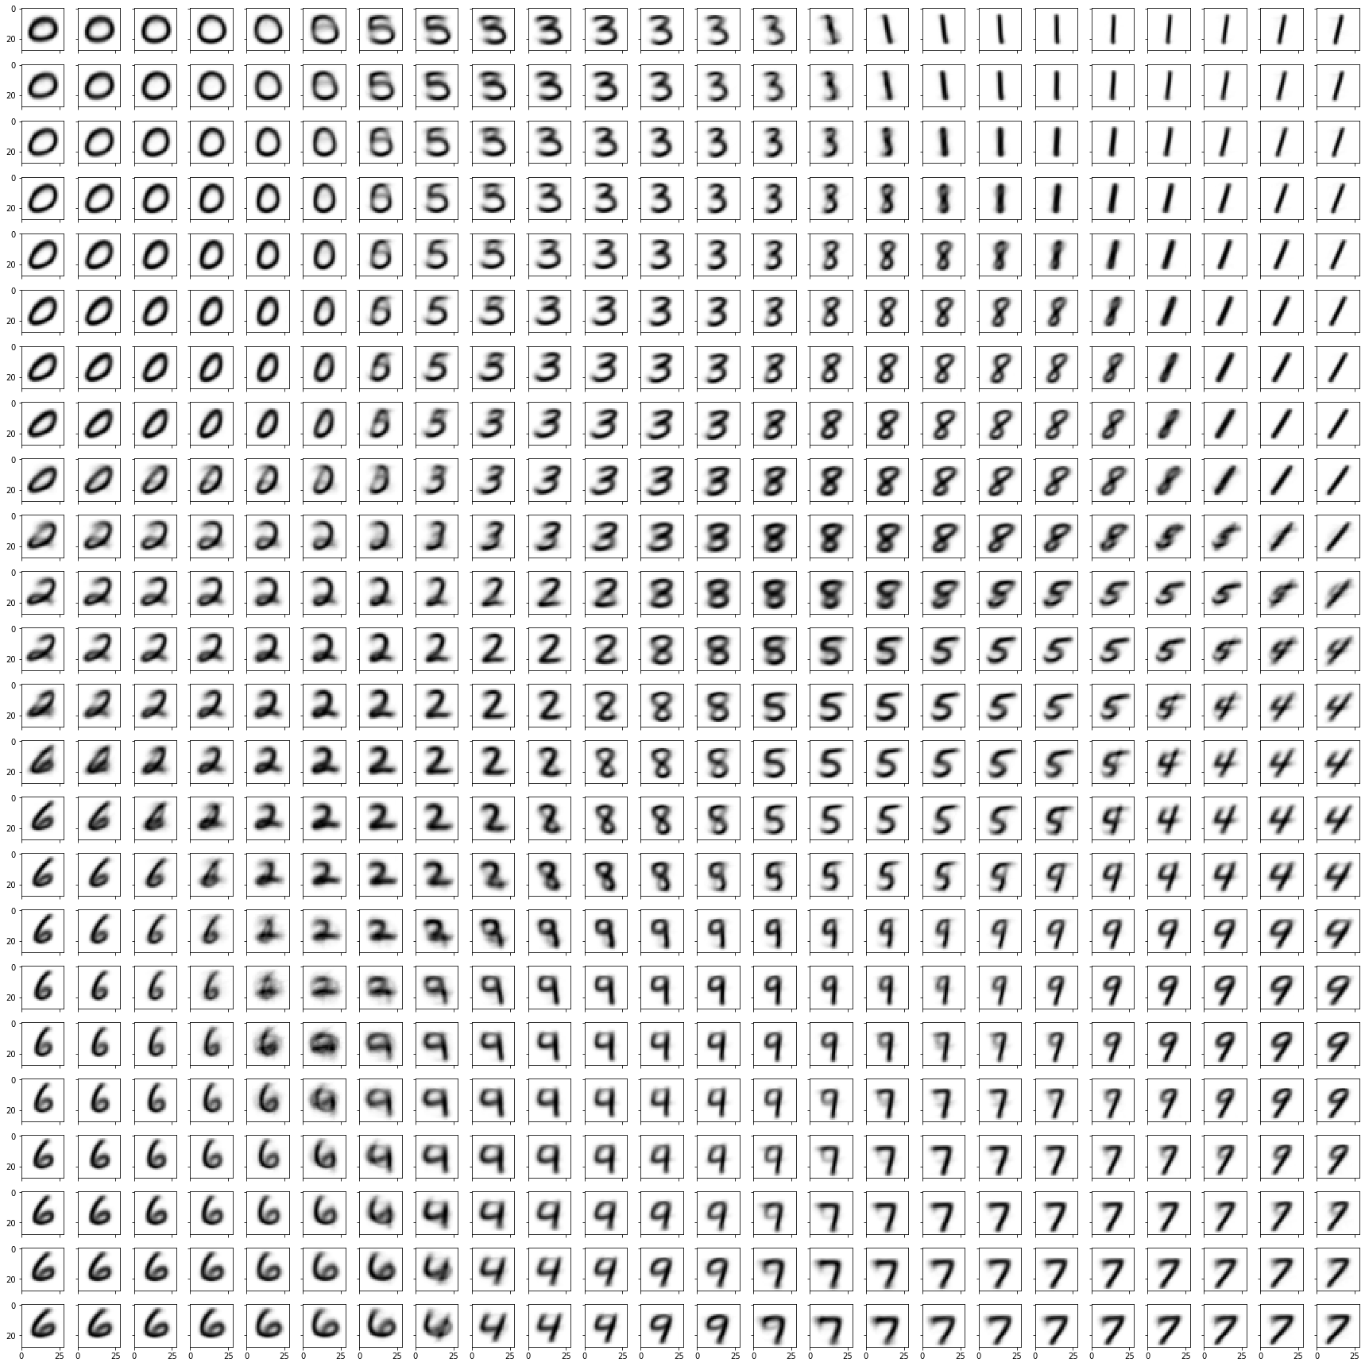
Inferring Structure in Data
Final weights for the neurons of a 24×24 SOFM trained on the full MNIST dataset (60,000 training points).

Slide 31
Inferring Structure in Data
Note the gradual tuning of neurons to leftward and rightward tilt of 1s.
Note the gradual tuning of neurons to the1s with a loop to those without a loop.
Final weights for the neurons of a 24×24 SOFM trained on the full MNIST dataset (60,000 training points).

Slide 32
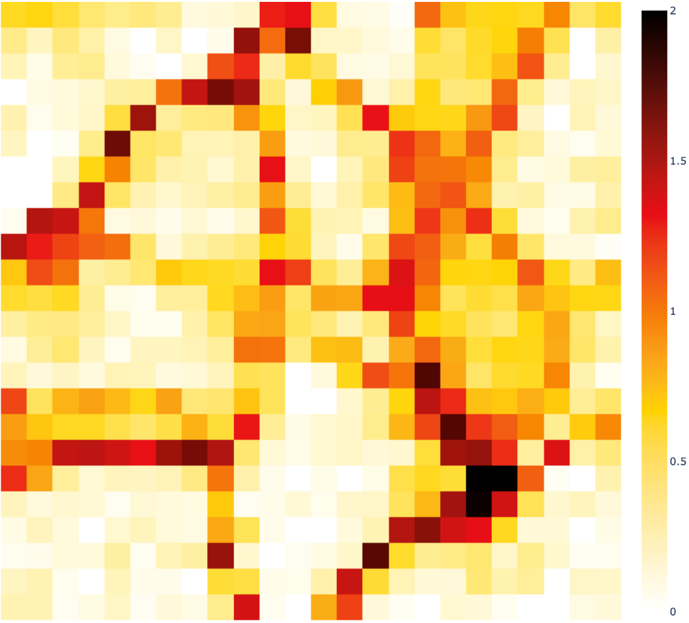
Inferring Structure in Data
Final weights for the neurons of a 24×24 SOFM trained on the full MNIST dataset (60,000 training points).
Specificity of the neurons on the full MNIST test set (10,000 points).
Can be used as the basis for classification.
From: A. Chawdhary & A.A. Minai (2018)

Slide 33
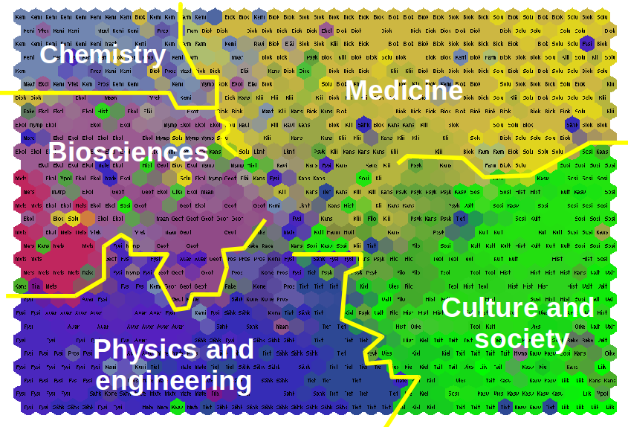
Inferring Structure in Data
T. Honkela (2013) Multimodally Grounded Translation, Tralogy II.
3,224 applications submitted to the Academy of Finland were analyzed.
Each application was represented in terms of extracted keywords.
The applications were grouped by an SOFM in keyword space.
Colors are assigned based on actual research area classes.
http://lodel.irevues.inist.fr/tralogy/index.php?id=259

Slide 34
Application to Supervised Learning
Given a data set with known class labels:
Stage 1: Self-organized clustering
Determine a relatively large number of clusters
using competitive learning or SOFM
Stage 2: Supervised aggregation
Combine clusters that belong to the same
class using LMS, perceptrons, backprop, etc.
Estimated
Class Label
Supervised
Network
True
Class
Label
Cluster Label
•
•
•
•
•
•
Unsupervised
Network
•
×
×
•
•
•
×
×
•
×
•
×
×
×
×
•
•
×
•
×
×
×
•
Data
•
•
×
The cluster centers can also be adjusted further
through supervised learning to improve the
classification → Learning Vector Quantization
×
•

Slide 35
Learning Vector Quantization
T. Kohonen (1989) Self-Organization and Associative Memory. Berlin: Springer-Verlag
Given a set of labeled data: { x^{k} , c^{k}}
Train a self-organized feature map on the data.
Label each neuron in the SOFM with a class based on its response to data (e.g., majority)
For N steps
- Pick a random data point, x^{q}
- Find the winning neuron i* and get its class label c(i*)
- Find the runner-up neuron i′ and get its label c(i′)
- If c(i*) ≠ c^{q} (mismatch)
and c(i′) = c^{q} :
and x^{q} lies close to the bisector of w_{i*} and w_{i′}
Else: do nothing
Does not require SOFM.
Can be done with competitive learning
Anti-Hebbian learning:
weight moves away from x^{q}
Hebbian learning:
weight moves towards x^{q}

